Slide 1

PhoenixSim Development
Code Structure and Analytical Models
LRL, Columbia University

Slide 2
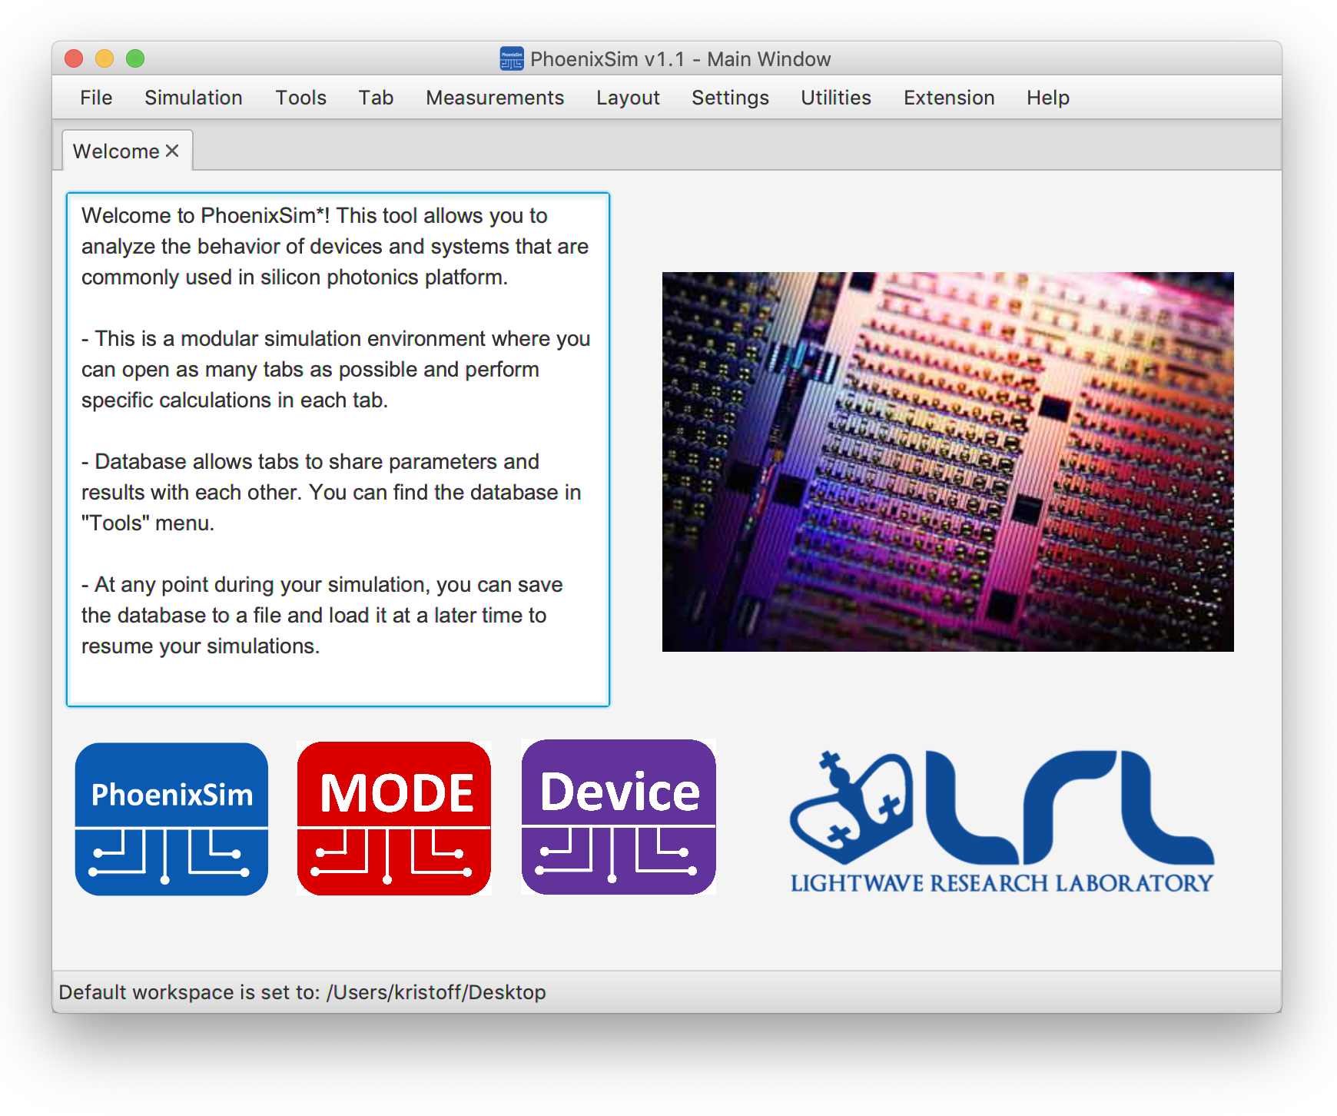
Overview
PhoenixSim performs powerful experiments for system-level analysis with its large library of photonic and electronic models.
Written in Java, PhoenixSim is a fully compiled, runnable jar file that can be easily distributed.

Slide 3
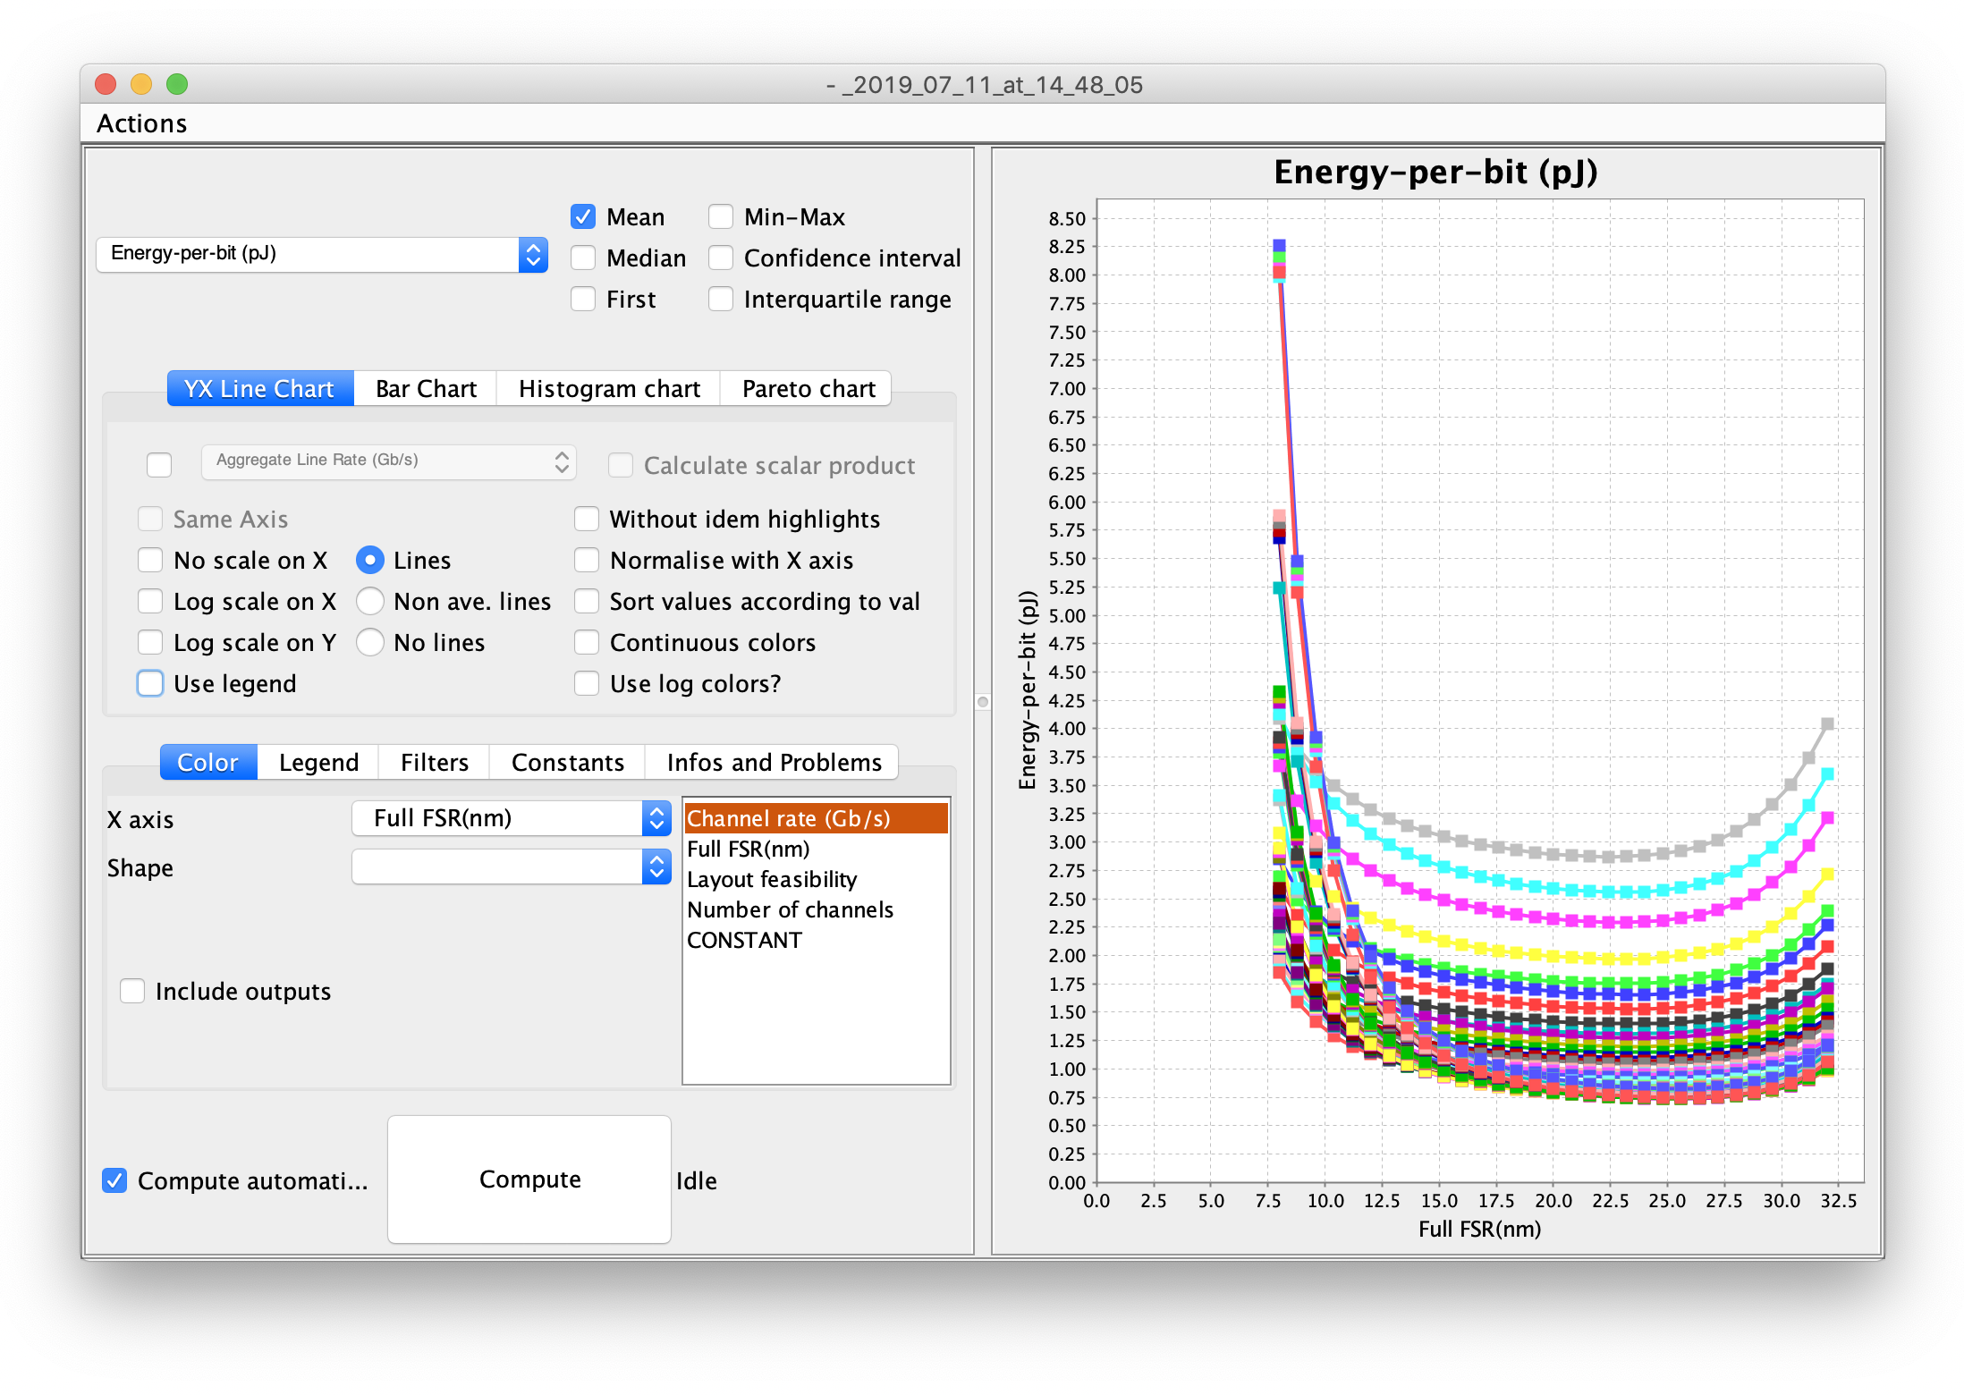
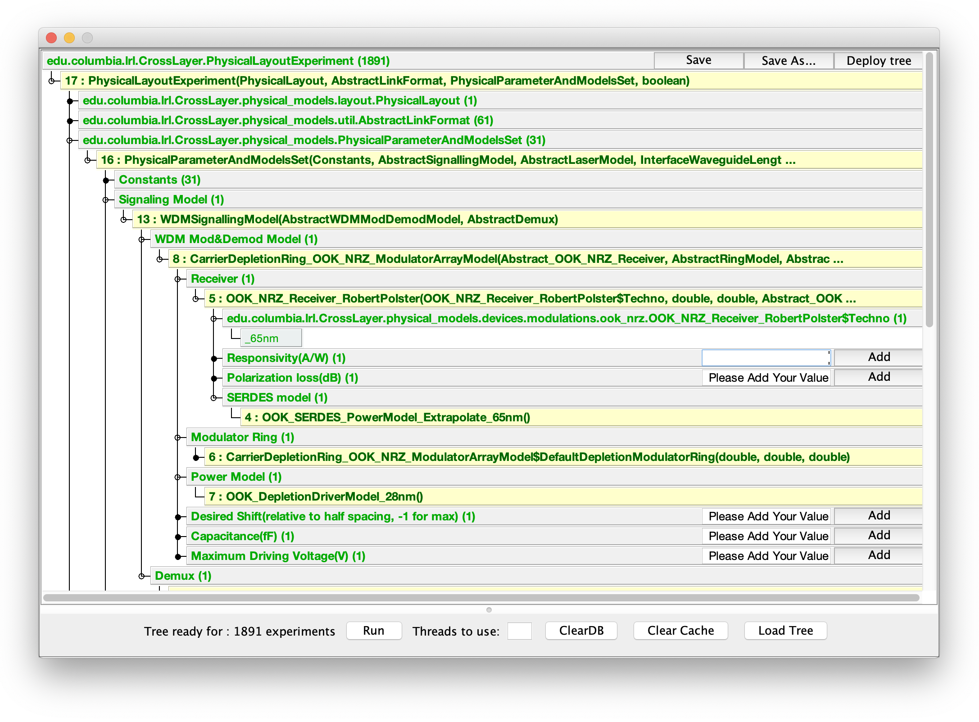
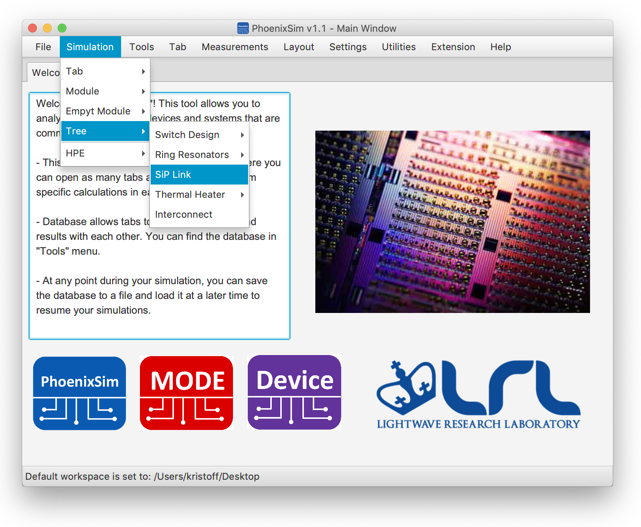
Overview
In SiP Link Simulation, two figures of merit are mainly investigated: Optical Loss and Power Consumption.
PhoenixSim simulation tree allows user to create, save or load custom experiments.
Result manager visualizes the simulation result for more intuitions. Powerful math functions and plotters enables fast filtering and graph generation.

Slide 4
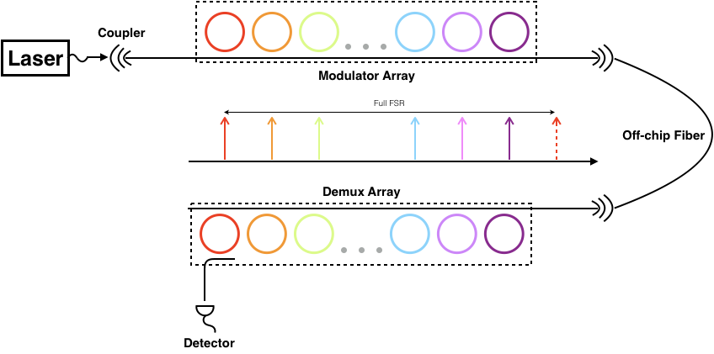
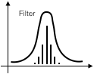
Simulation
Optical loss analysis based on photonic device models and optical signaling models, e.g., microring filter array:
A Lorentzian frequency response
Laser power calculated from receiver sensitivity and optical loss:
Total power consumption is simply the addition of laser power and electrical circuits consumption:
A typical photonic P2P link structure

Slide 5
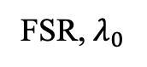
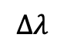
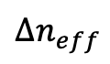
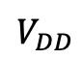
Device Modeling: Modulator array model
Quality Factor
Microring Model
$$Δλ$$
Optical Insertion Loss
Channel Crosstalk
FSR, $λ_{0}$
$${Δn}_{eff}$$
$$V_{DD}$$
Modulator Model
Driver energy consumption
Data Rate
The modulator array model considers both photonic, electronic and signaling parameters: FSR(free spectral range) of the microring, optical wavelength of operation, circuit driving voltage and also data rate.

Slide 6
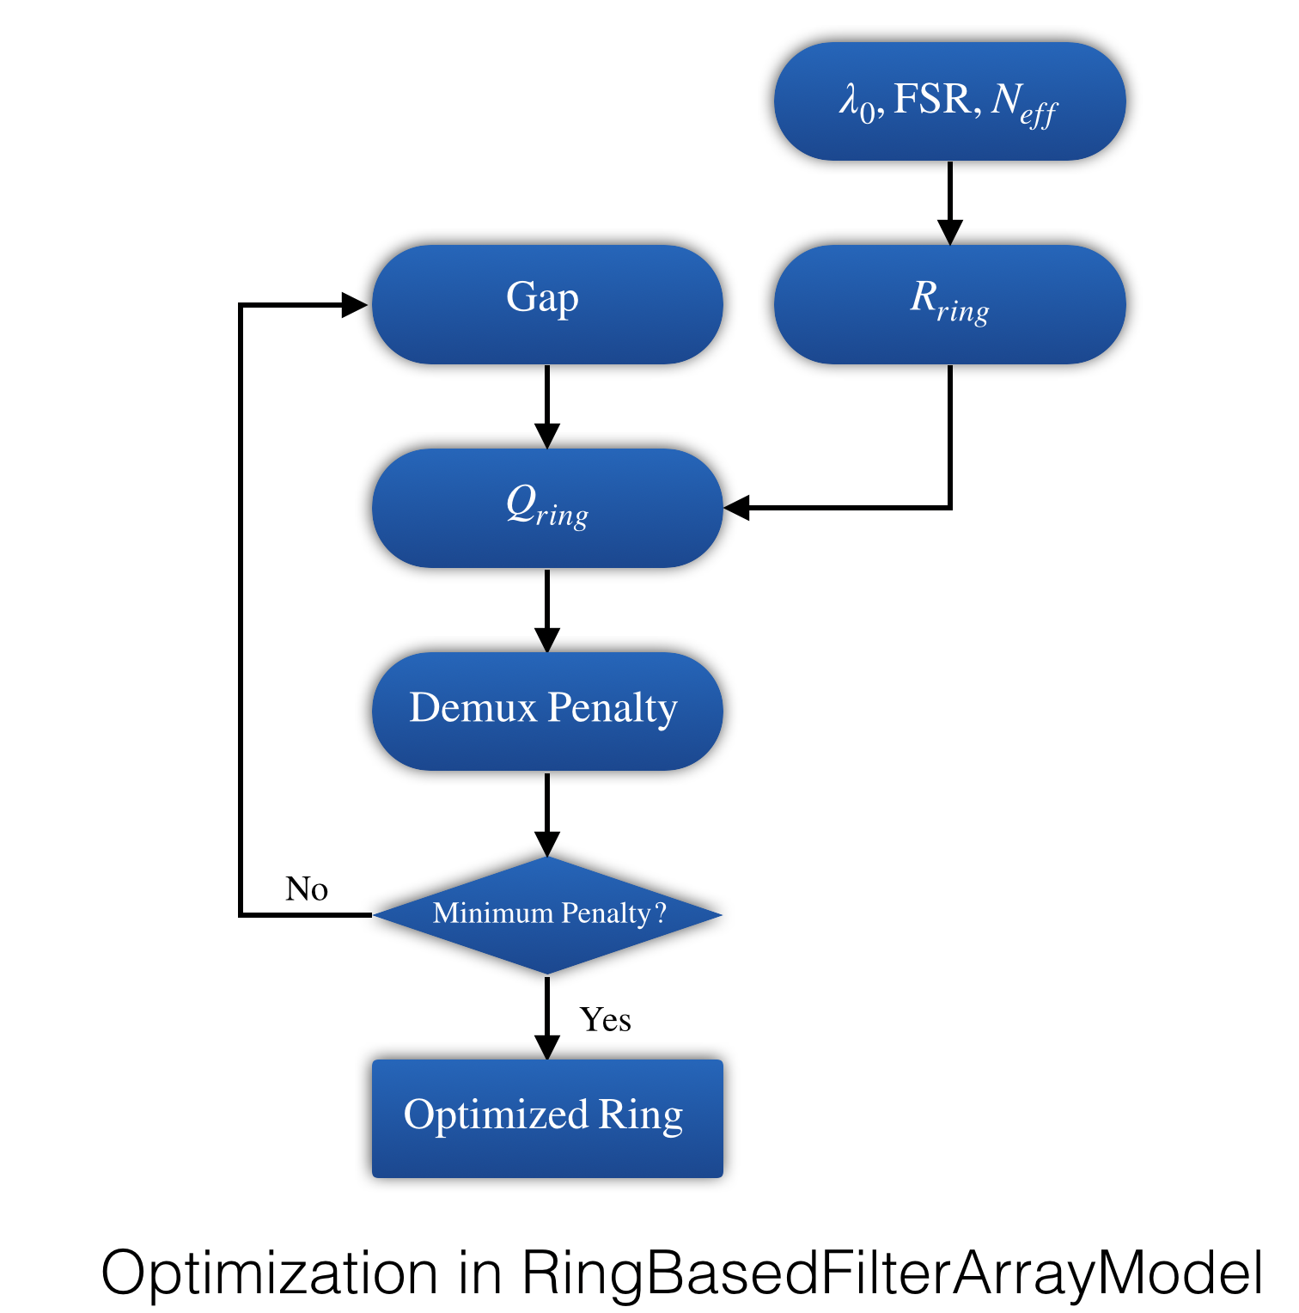
Device Modeling: Ring based filter array model
Optical loss is calculated based on the study of micro-resonators and coupled mode theory.
Like many other photonic models in PhoenixSim, the filter array model aims at its optical insertion loss and tuning consumption.
The model itself can adapt the ring-bus gap to deliver a minimum demultiplexing loss(penalty) to support higher data rate or lower energy use.

Slide 7
System level analysis
Laser power
Link Power Consumption
EIC power
Device Model 1
Laser
Device Model 1
Device Model 1
On-chip devices
Rx Sensitivity
Optical Loss

Slide 8
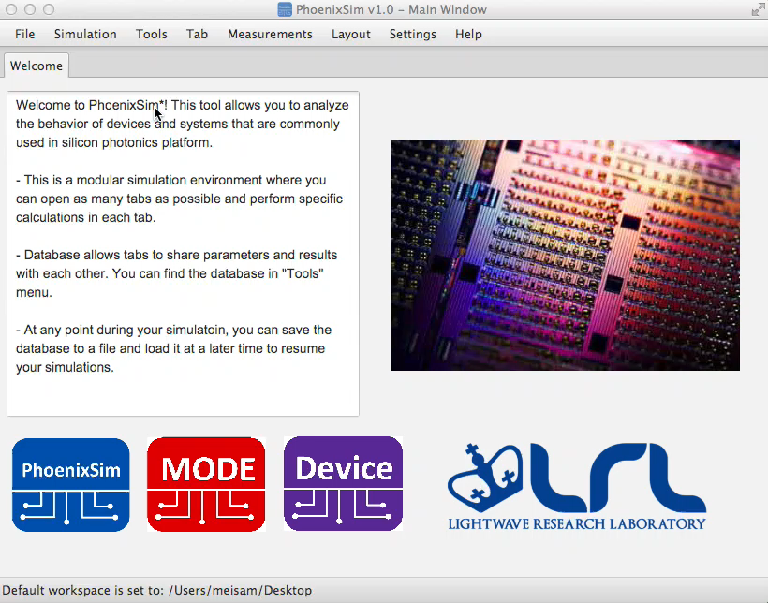
Demo: Carrier effects
Dl (nm)
I (mA)
Measured
Model
Play video to see the demo

Slide 9
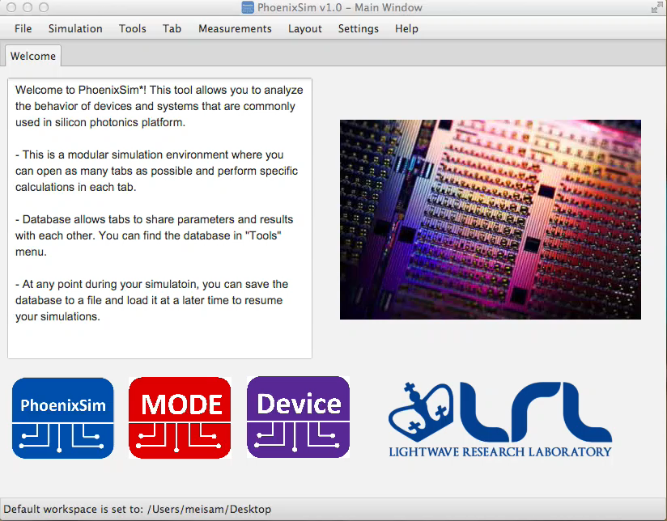
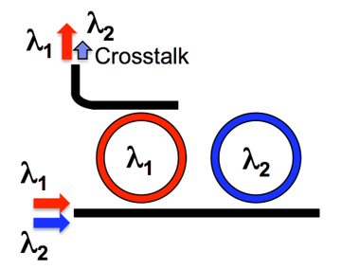
Demo: Demultiplex
l₁
l₁
Play video to see the demo

Slide 10
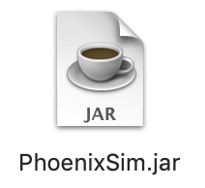
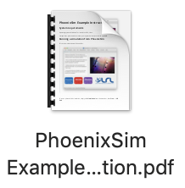
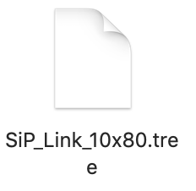
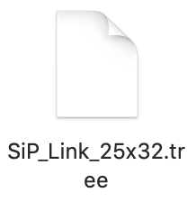
Example: End to End Design(Full Link)
Sweep FSR of rings
Please refer to the instructions attached to run the simulation.
Thank you!
Channel Spacing
Modulator characteristics
Filter array geometry
Power Budget
+
+
Max Data
Throughput
Lowest
Power/bit

